Slide 1
NEW PRESIDENT + NEW CONGRESS: THE NEXT FOUR YEARS
PAUL PRATHER, LITTLER, MEMPHIS
STEVEN SUFLAS, BALLARD SPAHR, DENVER

Slide 2



The Trump Administration:
What is in Store for Employers?

Slide 3
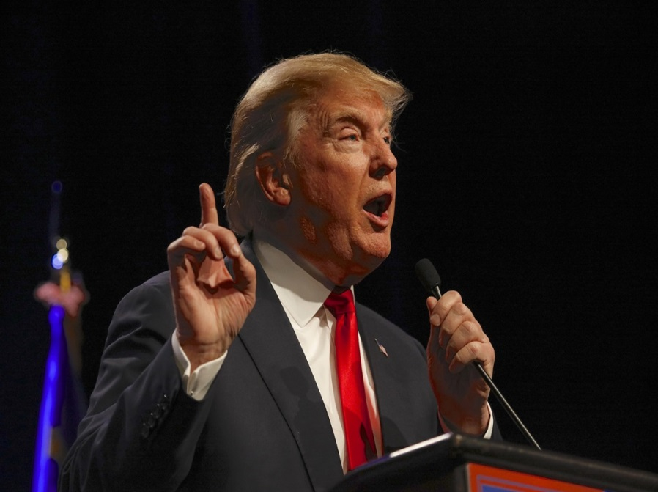
Impact of Trump Presidency for Employers
Presidential Appointments
SCOTUS
DOL
EEOC
NLRB
The Affordable Care Act
Overtime
Immigration
LGBTQ Rights

Slide 4
Early Actions by President Trump
Freeze on pending regulations
Executive order mandate of cost neutral regulations (1 for 2 rule)
Support for Congressional disapproval of President Obama’s “Fair Pay and Safe Workplaces” Executive Order
Directs DOL to review Fiduciary Rule
Issued executive order to minimize burdens under the Affordable Care Act

Slide 5

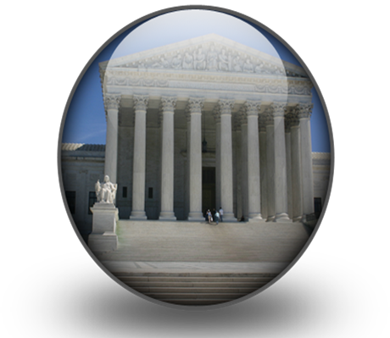

Slide 6
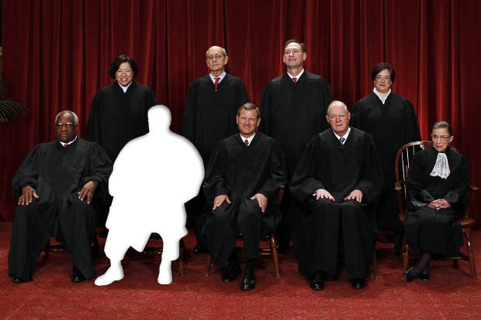
The Current U.S. Supreme Court
Passing of Justice Antonin Scalia has left a vacant seat
Current composition is evenly split between four Republican and four Democrat appointees

Slide 7
Trump’s Employer-Friendly Nominee
Hon. Neil Gorsuch, age 49, 10th Circuit
Clerk to Supreme Court Justices Byron White and Anthony Kennedy is a Columbia, Harvard and Oxford graduate who spent a decade in private practice in Washington before taking a top Justice Department job
Considered to be pragmatic consensus builder but friendly to employers

Slide 8
The Future U.S. Supreme Court
Potential for additional conservative Trump-appointees, as Justices Ruth Bader Ginsburg (age 83), Anthony Kennedy (age 80), and Stephen Breyer (age 78) are all liberal or moderate with retirement plans unknown
Trump will look for a conservative candidates to fill the vacancies
Any additional vacancy secures a conservative tilt to a 9-member Court

Slide 9
Decisions This Term
McLane Co. v. EEOC, No. 15-1248 [Arg: 2.21.2017] Issue(s): Whether a district court’s decision to quash or enforce an EEOC subpoena should be reviewed de novo, which only the Ninth Circuit does, or should be reviewed deferentially, which eight other circuits do, consistent with this Court’s precedents concerning the choice of standards of review
Gloucester County School Board v. G.G., No. 16-273 Issue(s): (1) Whether courts should extend deference to an unpublished agency letter that, among other things, does not carry the force of law and was adopted in the context of the very dispute in which deference is sought; and (2) whether, with or without deference to the agency, the Department of Education's specific interpretation of Title IX and 34 C.F.R. § 106.33, which provides that a funding recipient providing sex-separated facilities must “generally treat transgender students consistent with their gender identity,” should be given effect
Epic Systems Corp. v. Lewis, No. 16-285 Issue(s): Whether an agreement that requires an employer and an employee to resolve employment-related disputes through individual arbitration, and waive class and collective proceedings, is enforceable under the Federal Arbitration Act, notwithstanding the provisions of the National Labor Relations Act

Slide 10
SCOTUS Decisions in Peril?
Price Waterhouse v. Hopkins; Oncale v. Sundowner –Cases where the Supreme Court recognized Title VII protections against discrimination based on gender norms, which lower courts have used to award verdicts in sexual orientation discrimination cases
Legislation: The federal religious freedom laws could be amended to match Vice President Mike Pence’s controversial Indiana bill
A more conservative court would be less likely to read Title VII so expansively

Slide 11
SCOTUS Decisions in Peril?
Griggs v. Duke Power – A decision finding that employment practices which are neutral on their face but have a differential impact on race are discriminatory unless the Employer provides a substantial business justification
Future: Potential downfall of disparate impact discrimination
U.S. v. Arizona – Where the Court ruled that Arizona’s criminalizing the willful employment of illegal immigrants was preempted by Federal legislation
Future: Change to Federal law could eliminate the Court’s grounds for striking down the state statute

Slide 13
U.S. Department of Labor
President Trump’s initial appointee was Andrew Puzder, CEO of CKE Restaurants, the parent company of Hardees and Carl’s Jr. –now withdrawn
New appointee is Alexander Acosta
Former law clerk for Justice Alito
NLRB Board Member – 2003
DOJ – Civil Rights Division
Former U.S. Attorney (S.D. Fla.)
Dean – FIU Law School

Slide 14

New Directions for Department of Labor
Likely less litigation
Abolish persuader rule
Resource shift to compliance assistance
Support state right-to-work laws

Slide 15
Revisiting the New DOL OT Rule
Currently enjoined, that temporary injunction is on appeal
The Trump Administration, through the U.S. Department of Justice, can end the litigation, leaving the underlying ruling intact
Trump administration moved for a 30-day extension of its deadline to file its reply brief on appeal, “to allow incoming leadership personnel adequate time to consider the issues”
In addition, President Trump could work with Congress to pass a resolution under the Congressional Review Act (CRA) to repeal this rule
Alternatively, President Trump could direct the new Department of Labor to promulgate a new rule repealing Obama’s overtime regulation

Slide 16
Government Contractors
Reverse Executive Orders
EO 13706: paid sick leave
EO 13763: “Fair Pay and Safe Workplaces” requires employers to inform employees of exempt/ independent contractor status and hours/pay data
EO 13673: Blacklisting for labor law violations
Revisions to Obama Administration’s OFCCP regulations

Slide 17

OSHA
In Trump’s crosshairs:
Penalty increases (close to 80%)
Injury and illness reporting requirements
Raise complainants’ prima facie burden
Union officials allowed on non-union worksites
Increase state plans’ jurisdiction
Shift towards compliance assistance

Slide 18
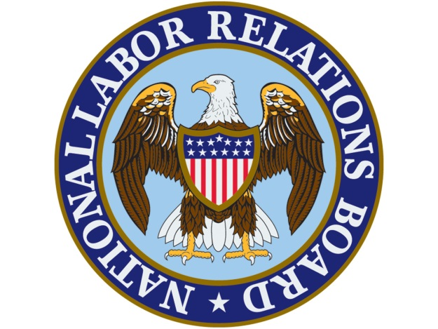

Slide 19
The Composition of the NLRB
Board has five members – two current vacancies
Board Members are appointed by the President to 5-year terms, with Senate consent, the term of one Member expiring each year
There are two current vacancies and President Trump will be able to replace two outgoing members in next two years
New Appointees will likely lead the Board away from recent pro-union activism
Trump has named Phillip Miscimarra, a current board member, as Acting Chairman
General Counsel sets NLRB’s prosecutorial agenda

Slide 20
The National Labor Relations Board
Current Board
Mark Gaston Pearce, Chairman (D) – exp. August 2018
Philip A. Miscimarra (R) – exp. December 2017
Lauren McFerran (D) – exp. December 2019
General Counsel
Richard Griffin, Jr. (D) – exp. November 2017

Slide 21

Changes in NLRB Direction
Despite the General Counsel’s assertion that he will continue to advance his objectives, a shift to more employer-friendly labor policy is likely
But, it will not happen overnight
GC will likely continue to pursue his priorities and Board composition won’t change immediately

Slide 22
Revisiting Recent NLRB decisions
Likely forced return to longstanding precedents
Class Action Waivers –SCOTUS will revisit Board’s 2012 decision in D.R. Horton. Court will likely reaffirm the supremacy of the Federal Arbitration Act and the right to enter into voluntary agreements to use individual arbitration.
Joint Employer Standard – Republican Congress will likely pass legislation to undo the Board’s 2015 decision in Browning-Ferris, which loosened the Board’s standard for determining joint employers. Decision allowed for a secondary employer to merely retain the right to control work to be considered joint-employer. New legislation will return law to old standard where secondary employer need actually exercise control to qualify as joint-employer.

Slide 23
Potential NLRB Actions
Revise “quickie election rule”
Scale back expansion of protected conduct under Section 7 on NLRA
Reconsideration of Specialty Healthcare
Reverse D.R. Horton
Member Miscimarra dissented in Murphy Oil, disagreeing strongly with the Board’s non-acquiescence on the DR Horton issue
Member Miscimarra criticized the NLRB majority for treating the NLRA as the "protector of class action procedures under all laws, everywhere"

Slide 25
Composition of the EEOC
Five Commission members and the EEOC General Counsel are appointed by the President
There is one current vacancy on the Commission and all current members’ terms will expire before the end of Trump’s presidency
President has named current commissioner Victoria Lipnic as Acting Chair
Commissioner Lipnic is known as pragmatic and understanding of business realities

Slide 26
EEOC Practices: Year In Review
EEOC’s FY2016 statistics showed a greater focus on systemic cases but a reduction of the overall cases filed
The EEOC defines systemic discrimination as "pattern-or-practice, policy and/or class cases where the alleged discrimination has a broad impact on an industry, profession, company or geographic location”
Analysis shows that there is a 40% greater likelihood of a cause finding when faced with a systemic investigation, as compared to the fact that the EEOC historically has issued reasonable cause findings in less than 5 percent of the charges filed with the agency

Slide 27
EEOC: The Future
Strategic Enforcement Plan 2017-2021
Temporary workers/independent contractors
Equal pay
LGBTQ rights
EEOC will continue to pursue its objectives, but likely with a more tempered approach and smaller budget.
While the EEOC’s Strategic Enforcement Plan demonstrates a commitment to systemic investigations, Republicans in Congress may require a majority vote by Commissioners before commencing litigation with multiple plaintiffs or systematic pattern and practice allegations.

Slide 28
EEOC: The Future
EEO-1 Pay Transparency Changes – Current regulation requires all businesses with 100 or more workers to submit pay data by gender, race and ethnicity for workers in 12 different specified pay bands by March 2018.
Confidantes of Acting Chair Lipnic have been quoted as saying she disapproves of this regulation
Trump Administration will likely put this regulation on its chopping block
EEOC wellness rules – criticism from both sides and may be revisited

Slide 29

Repeal of the Affordable Care Act
Total and immediate repeal is not likely
20 million enrolled
Could take up to 4 years
Provisions likely cut
Individual mandate
“Cadillac Tax”
Employer mandate

Slide 30

Trump Care?
Provisions likely retained
Coverage for children to age 26
Pre-existing conditions
Wait and see
What is “replace”
Will depend on
Congress

Slide 31
Other Issues Impacting Employers
Continued activities by state and local authorities to regulate labor and employment
Immigration reform uncertainty
Employee political activism

Slide 32
NEW PRESIDENT + NEW CONGRESS: THE NEXT FOUR YEARS
PAUL PRATHER, LITTLER, MEMPHIS
STEVEN SUFLAS, BALLARD SPAHR, DENVER

